Slide 1
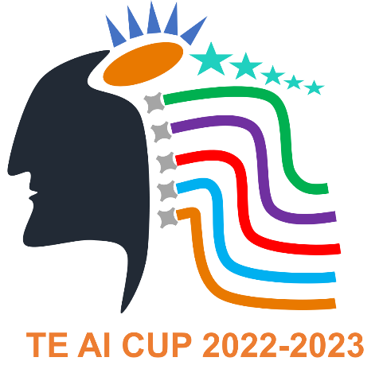
Demand Forecasting
Team Name: Team Paper Pushers
University : PCCOE , Pune
Country: India
Engaged TE Plant: Wagholi

Slide 2
Outline
Project Team
Project Overview
Innovation Description
Business Value
Self - Scorning

Slide 3

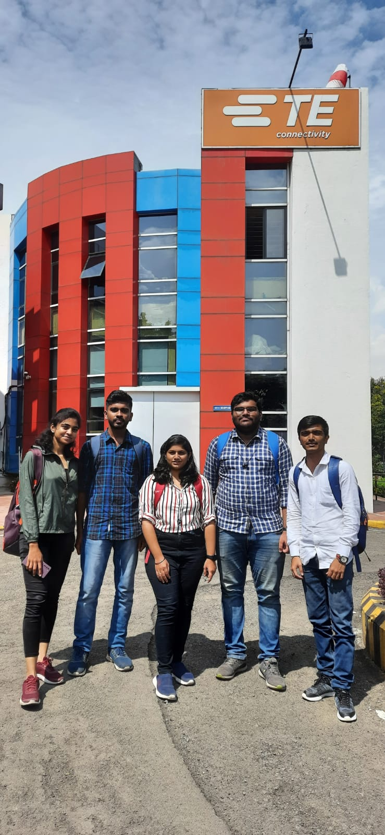
Project Team
University Name: PCCOE , Pune
Team Name: Team Paper Pushers
University Advisor:Rahul Dige sir
TE Advisor: Prity Bagad
TE Plant Engaged: Wagholi
 | Name | Grade | Major
Team leader | Prathamesh Khade
Team Member | Animesh Wankhede
 | Nikhil Issac
 | Shreya Deshpande
 | Sudhiksha Pujari
Team Photo

Slide 4
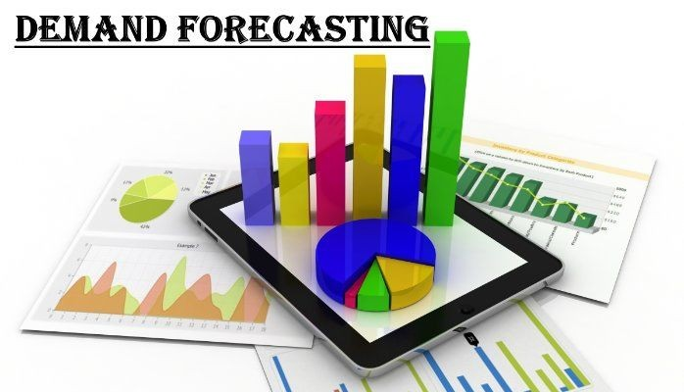
Project Overview
Background: As an intern team in demand forecasting for TE connecivity, we were tasked with developing a solution that would automate the demand forecasting process, reduce errors, and improve accuracy. The company's existing process was manual and time-consuming, and did not have the ability to predict sudden changes in demand patterns.
Problems to be solved: The main challenge that we faced was to develop a solution that could accurately predict demand, taking into account various factors such as seasonality . We had to ensure that our solution was data-driven, automated, and could provide accurate forecasts in real-time.
Project Achievements: To address these challenges, we developed a machine learning model that could predict demand based on historical sales data, seasonality. We also developed a dashboard that could display the forecasts in real-time, allowing TE connectivity to optimize its inventory levels based on the predicted demand. Our solution was able to reduce errors, improve accuracy, and save time, allowing TE connectivity to make data-driven decisions.

Slide 5
Innovation Description
Describe System Concept / Solutions. Pictures will be helpful
We developed a demand forecasting system that leverages machine learning algorithms to predict future demand based on historical sales data, seasonality. The system is designed to provide real-time demand forecasts, allowing TE Connectivity to optimize its inventory levels and reduce costs.
Describe the key functionalities, and AI functionalities
Data Collection: The system collects sales data, as well as data on seasonality.
Data Processing: The collected data is processed and transformed into a format that can be used by the machine learning algorithms.
Machine Learning: The machine learning algorithms are trained on historical sales data and other relevant data sources to develop accurate demand forecasting models.
Real-time Forecasting: The system provides real-time demand forecasts that take into account current market conditions, allowing [Company name] to adjust its inventory levels accordingly.
Dashboard: The system also includes a dashboard that displays the demand forecasts and provides insights into the key factors driving demand.

Slide 6
Application Features and Business Value
You may summarize the features from below points
AI Innovation
Our demand forecasting system leverages machine learning algorithms and predictive analytics to accurately predict future demand
AI Feature
The AI features of our demand forecasting system include:
Machine Learning: Our system uses machine learning algorithms to develop accurate demand forecasting models that can identify patterns and trends in historical sales data, and use this information to make predictions about future demand.
Predictive Analytics: Our system uses predictive analytics to identify trends and patterns in data that may be indicative of future demand.
Real-time Forecasting: Our system provides real-time demand forecasts that take into account current market conditions.
Benefits to TE/Industry:
The benefits of our demand forecasting system include:
Improved Efficiency: Our system automates the demand forecasting process, reducing errors and saving time.
Improved Quality: Our system provides accurate demand forecasts.
Improved Cost-effectiveness: Our system can help to reduce costs associated with overstocking and stockouts.

Slide 7
Deployment Opportunity:
Business Value:
The business value of our demand forecasting system is calculated based on the estimated annual savings or revenue generated.
For example, if the system is expected to reduce overstocking by 20% and stockouts by 15%, resulting in an estimated annual savings of $500,000, then the business value of the system would be $500,000 per year.
Our demand forecasting system has a wide range of potential applications, including:
In TE's factories: The system can be used to optimize inventory levels for TE's manufacturing processes, reducing costs and improving efficiency.
In TE's supply chain: The system can be used to optimize inventory levels for TE's supply chain, reducing costs and improving delivery times.
In other manufacturing processes: The system can be adapted to other manufacturing processes, allowing companies to optimize their inventory levels and reduce costs.

Slide 8
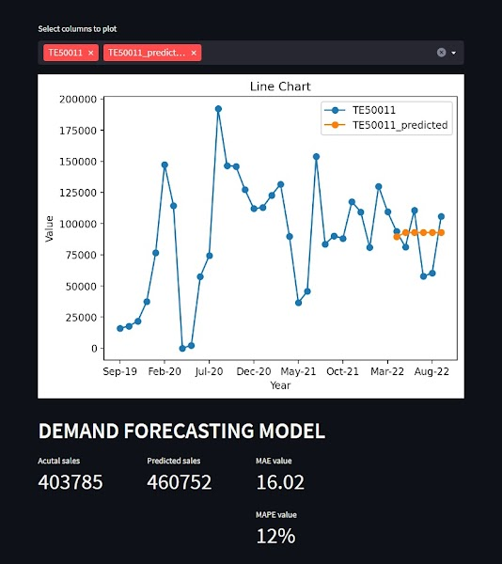
Dashboard

Slide 9
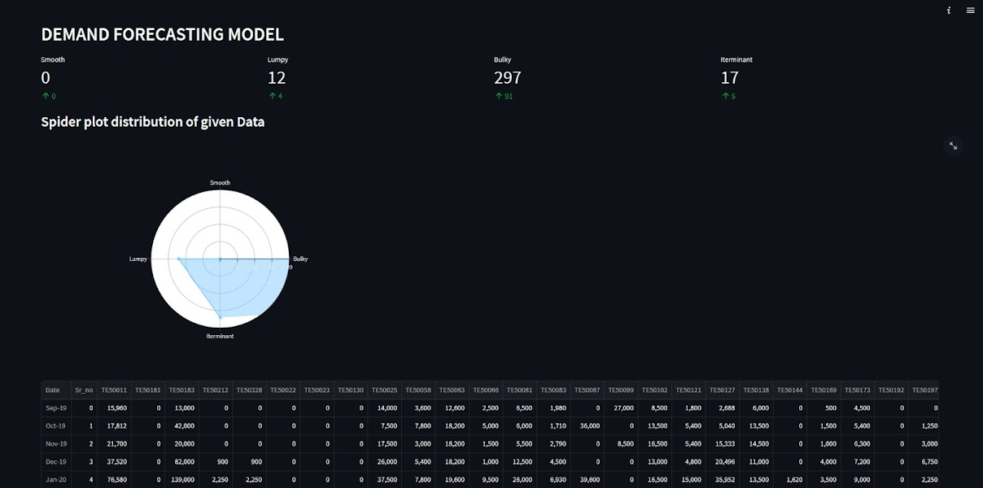
Dashboard

Slide 10
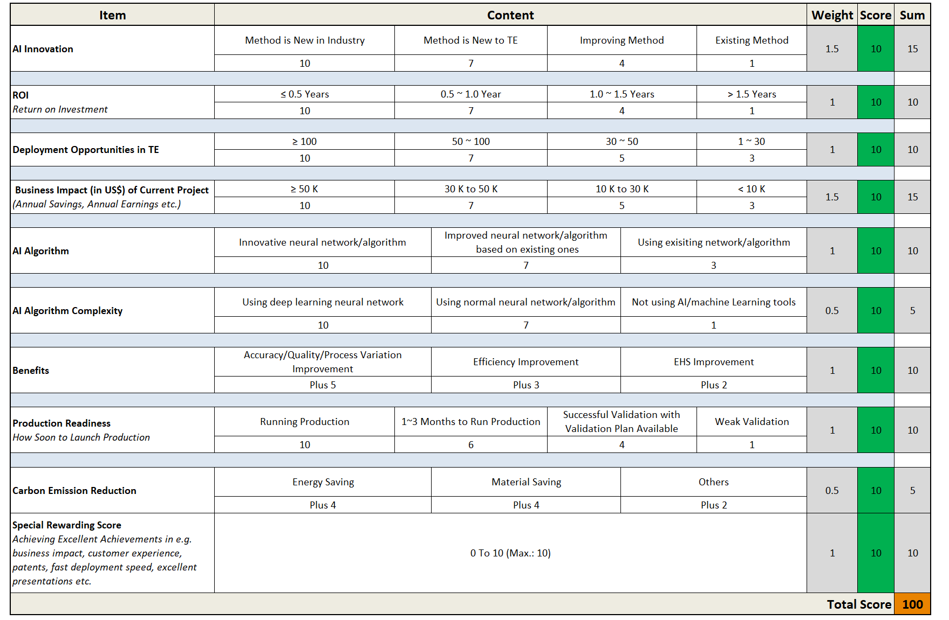
Scorecard (Give Your Self-assessment Scores)

Slide 11
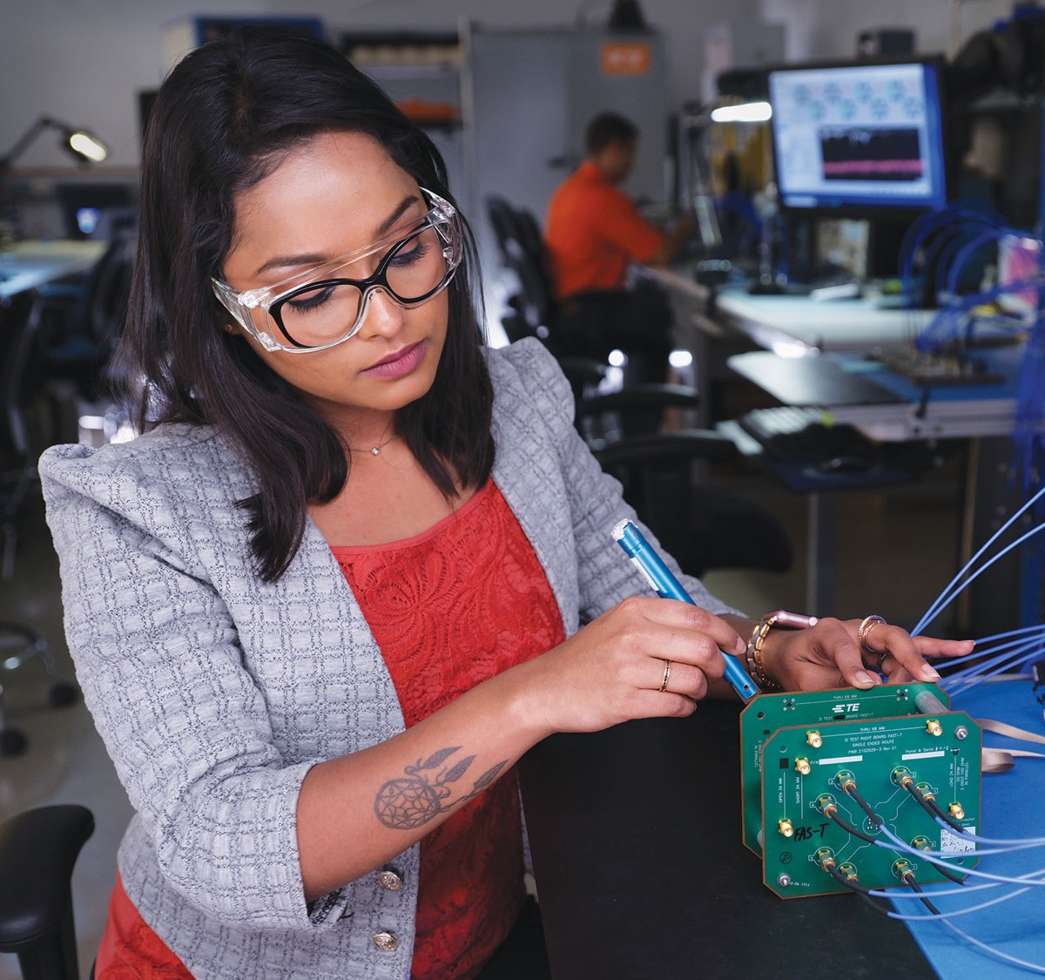

Two Minutes for TE Advisor
TE Advisor Name

